Slide 1
DRONE MISSION PLANNING SOFTWARE
Taylor Trabun David Klingenberg
Emeth Thompson Joe Higley
University of Idaho – Moscow, ID

Slide 2
Overview
Problem Definition
Project Status
Goals & Plans
Hardware
Communications
GUI
Demo
Q & A

Slide 3
Problem Definition
The goal of this project is to design and develop a graphical user interface (GUI) for drone mission planning.
Requirements:
User friendly interface
Allow 3D mission planning
Upload the flight plan using XAPI and Xbee
Allow Manual Override during flight
Implement Drone Hardware for flight control

Slide 4
Project Deliverables
Alpha version of Graphical User Interface (GUI)
Integrated prototype instrument panel into GUI (Code by Guillaume CHOUTEAU )
Arduino firmware for home and drone with xapi and drone services
Basic communications integrated with drone and GUI
Fully configured drone hardware
Initial drone prototype firmware

Slide 5
hardware

Slide 6
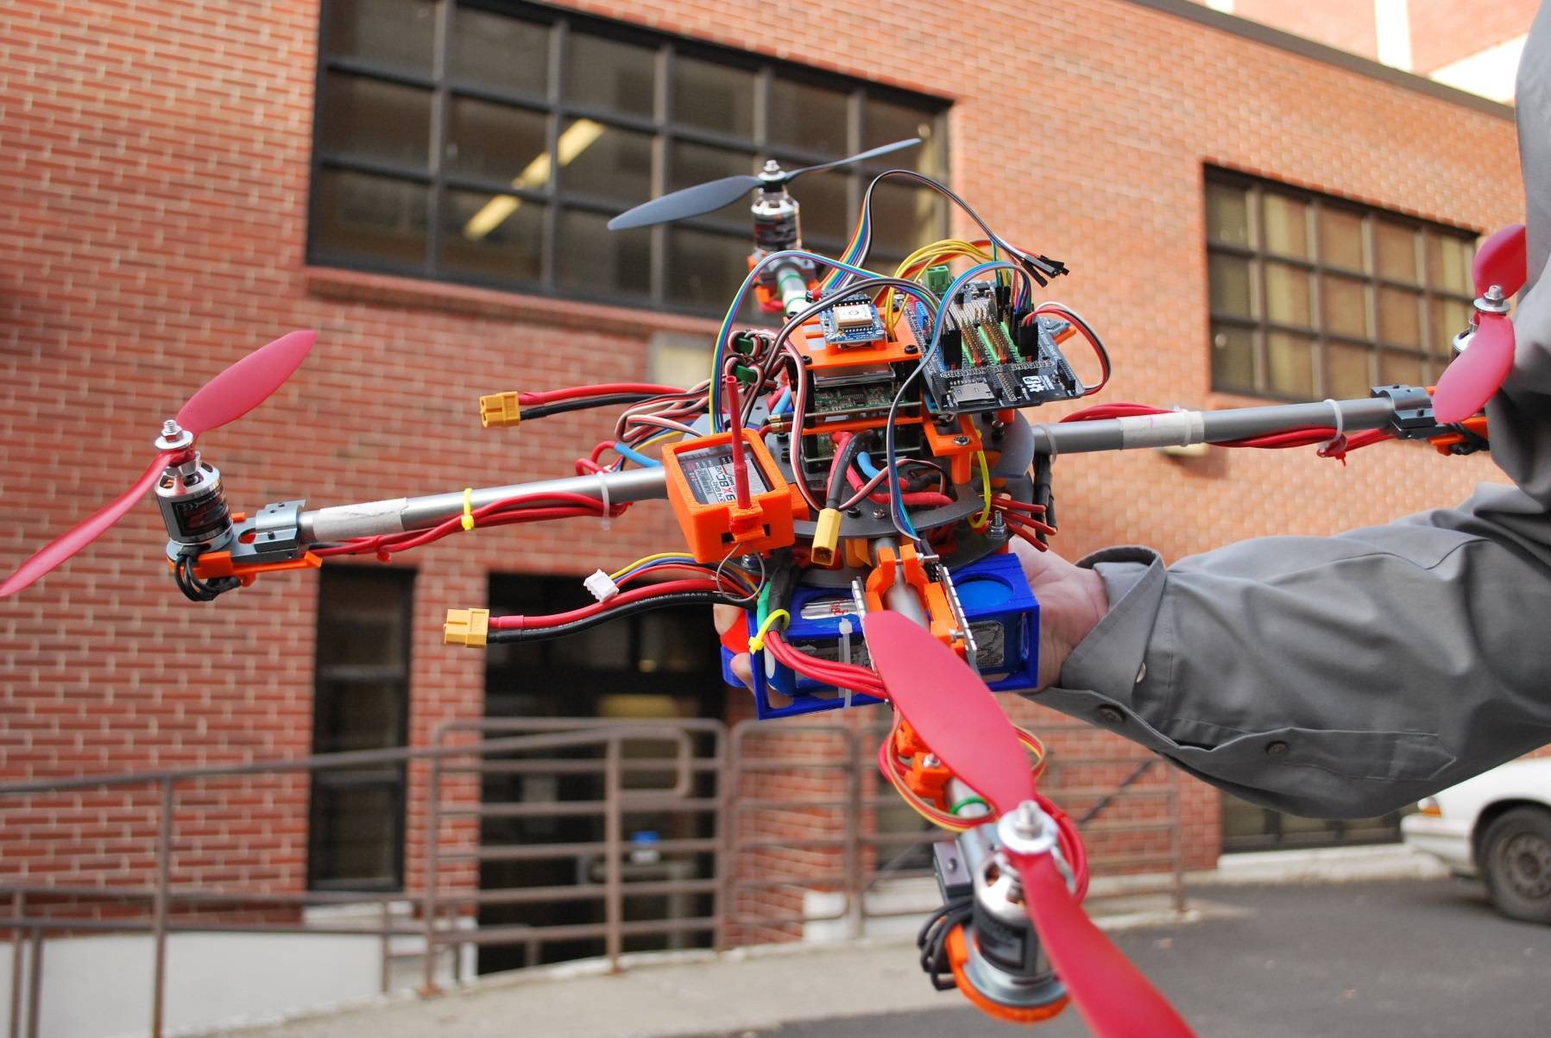
hardware

Slide 7
Firmware
Arduino firmware uses xapi to manage services that control different aspects of communication
Home firmware for Arduino connected to Windows PC running mission control software
relays packets, over a serial connection, to the Arduino then over xBee modules to drone Arduino
Drone firmware for driving flight computer
Enables automatic or manual control
Auto pilot manipulation via xapi services we developed

Slide 8
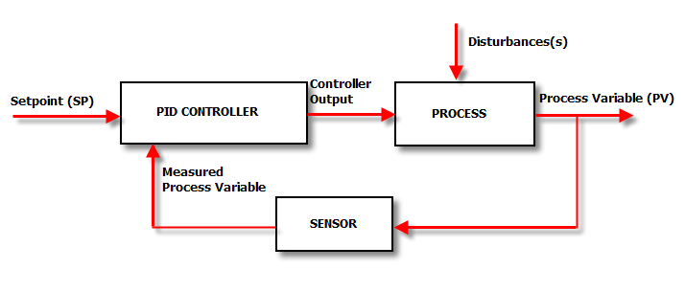
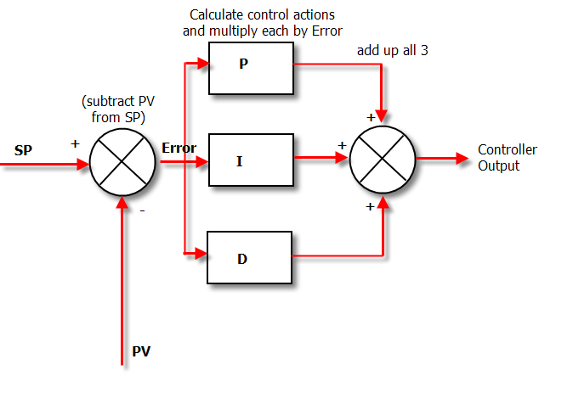
Firmware

Slide 9
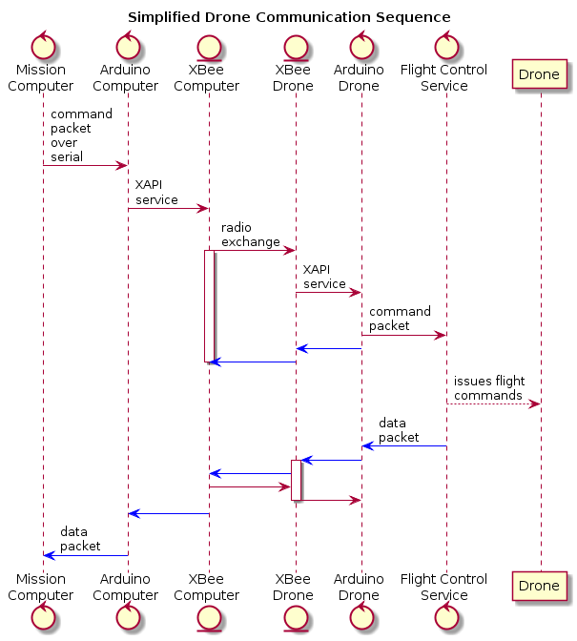
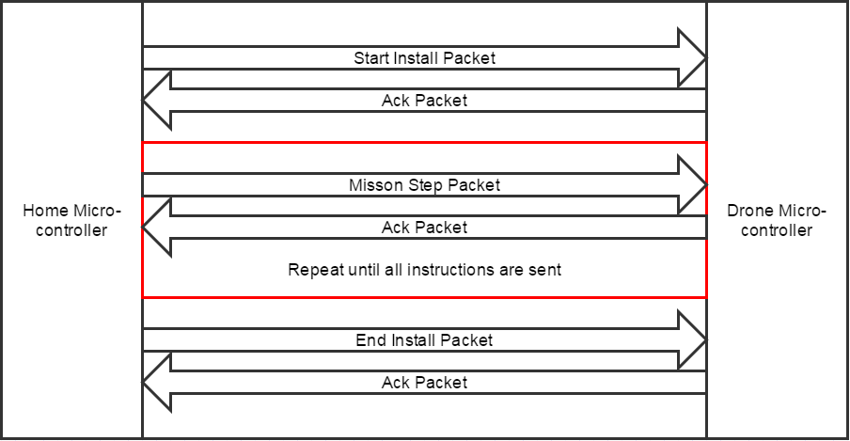
Communication Designs

Slide 10
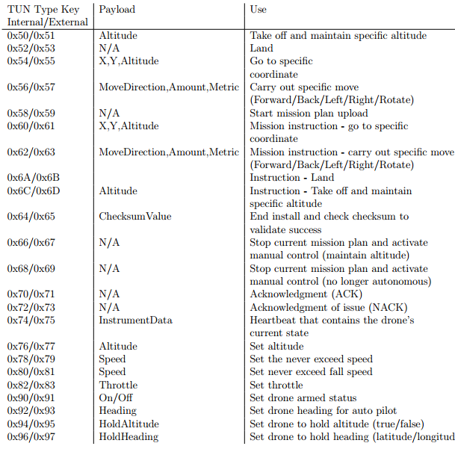
Communication Packet Types

Slide 11
Services (Fully IMplemented)
AltitudeHold Service
Arm Service
DoMove Service
Heading Service
HeadingHold Service
Land Service
Updated Serial Service
Takeoff Service

Slide 12
Future Services Required
Heartbeat Service (In progress)
MissionPlanInstruction Service
MissionPlan Service
Move to Coordinate Service
DroneSettings Service

Slide 13
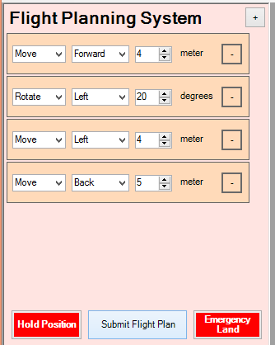
Mission Control Software
Flight Plan Panel
Able to create and submit flight plans with many instructions.
Instructions implemented:
Move: Forward, Left, Right and Back
Rotate: Left Right
Instructions can be added and subtracted before being resubmitted.
Emergency buttons for pausing flight and forcing a landing are clearly indicated.

Slide 14
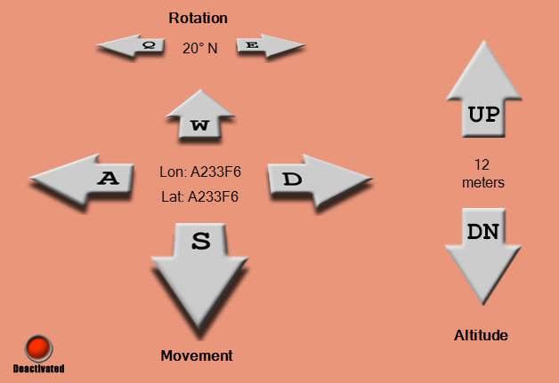
Mission Control Software
Manual Control Panel
Controls can be activated or deactivated
Controls can use either keyboard keys or mouse clicks.
Future improvements:
Data displays need to be updated from the drone packet.
Restrict key select to only one key at a time.

Slide 15
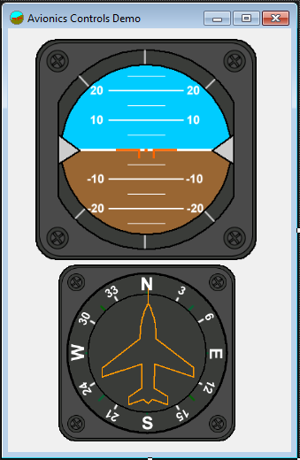
Mission Control Software
Instrument Panel
Library courtesy of Guillaume Chouteau
Currently monitors the pitch, roll and yaw of the drone’s Arduino
String parsing extrapolates the data and then translates to a format readable by the instrument panel library.

Slide 16
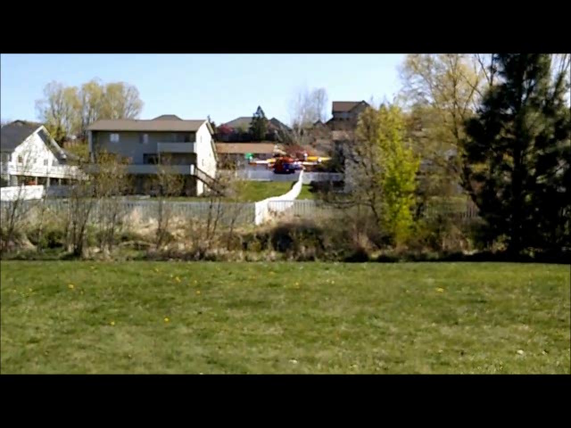
Testing (auto Pilot)

Slide 17
Thank you Questions?

